Slide 1

Development of RShiny Web App for Incremental Response Modeling of Data
Supervisors:
Prof. Dr. Christina Andersson
Prof. Dr. Andreas Orth
Master Thesis Presentation
by Akshay Laddha (1098383)
May 18, 2017
Master of Engineering
(Information Technology)
Frankfurt University of Applied Sciences

Slide 2
Outline
Thesis Goal
Background and Motivation
NIV- Variable Pre Screening
Incremental Response Modeling
Results with R Shiny Web App
Conclusion and Future Work
Notes:
Todays presentation is divided into following sections.
First I will start with describing the Thesis Goal. Then will give a walk through with the theoretical background and Motivation behind this research topic.
Next, I will explain the Net Information Value method, the variable pre screening step implemented in this thesis work
After this we will go thru the theoretical concepts of Incremental Response Modeling.
I will then demonstrate the working of the R shiny web app and will explain the results obtained from it.
At last, I will conclude the presentation with the Conclusion and future scope and improvements.

Slide 3
Thesis Goal
Every company wants their customer to respond positively to their marketing offer.
Traditional Response models usually divides the customers into two categories.
Respondents
Non Respondents
Thus new type of response model is required.
“To develop a web application which will be used to build Incremental Response Model used to predict the persuadable customers”
Notes:
Lets start with the Thesis Goal.
Main aim of this thesis work is to implement a user interface where any user can build a incremental response model on the data.
So what exactly is an incremental response modeling?
Every company wants their customer to respond positively to the offers made by them to the customers.
To predict this, usually they use some traditional response models which will categorise the customers in two categories. Either they respond or they don’t respond.
Thus there is a need of some new technique to improve these predictive method. This introduced a new technique to predict the response known as incremental response modeling.
We will go in detail in further slides. Lets move to background and motivation behind this modeling technique.

Slide 4
Thesis Goal
Background and Motivation
NIV- Variable Pre Screening
Incremental Response Modeling
Results with R Shiny Web App
Conclusion and Future Work

Slide 5
Background and Motivation
Drawbacks of traditional response models introduced a need of new type of response models.
It did not account those customers who were not subjected to any offer.
Could lead to invest money on those who could have bought the product anyways.
Could disturb the do not disturb category of customers.
Thus a new approach which consider the customer’s behavior to the marketing action.
Successful implementation of IRM: Obama's 2012 Presidential Election Campaign.
Incremental Response
Notes:
Drawbacks of Traditional response models are the main motivation behind introducing IRM. So first lest cover the Traditional Response models.
So what exactly such response models do?
In the first step, every company approaches their customers with some marketing actions. They record customers response to the action. Using this data they build a predictive model which predicts that the customer will buy the product or not.
So this does not take account on some points:
What about those customers who were not subjected to any offer.
We might be targeting those who anyways would have bought the product.
Might disturb the DND customers.
Which brings us to our thesis topic. Incremental Response Modeling.
There is a very popular example of successful implementation of IRM.
Barak Obama’s 2012 presidential election campaign.
Back is 2010, many analysts were predicting Obama’s loss in coming 2012 election.
Obama’s campaign managers knew that he cant win just with his loyal vote base.
So they hired a team of 50 data scientist and analysts to predict which voters will respond positively if Obama had a campaign in their area. This resulted in significant rise in Obama’s voter base.

Slide 6
Background and Motivation
Traditional Response models scores the customers based on their likelihood to purchase.
P(response/Treatment)
Traditional Response Models
Notes:
Traditional Response models scores the customers based on their likelihood to purchase.
P(response/Treatment)
This is the simple flow chart of Traditional response modeling technique.
In this, a predictive model is built on the data from previous campaign. This model is then used to predict the customer who will buy the product.

Slide 7
Background and Motivation
Buy only if targeted with marketing action: Persuadable
Buy regardless of marketing action: Sure Things
Never buy regardless of marketing action: Lost Cause
Will not buy if targeted with marketing action: Do not disturb or sleeping dogs
Types of Customers
Notes:
So basically a customer can be categorised in four different categories:
Thus every company will want to target only the persuadable customers.

Slide 8
Incremental Response Model
Whereas Incremental Response Models predicts the customer by using the change in customer's behaviour because of the marketing action.
P(response/Treatment) - P(response/No Treatment)
One of the method to find out the net lift is to calculate the difference score.
Types of difference model approaches :
Two Model Approach
Combined/Single Model Approach.
Basic Incremental Response Models
Treatment Data: Customer who received a marketing offer
Control Data: Customers who did not receive any marketing offer
Notes:
Whereas Incremental Response Models predicts the customer by using the change in customer's behaviour because of the marketing action.
This is the basic flow chart of Incremental response modeling technique.
The data is first divided into Treatment and Control data set.
Treatment data includes those customer who were subjected to marketing action.
Control data includes those who were not subjected to any marketing action.
Then the model is built to calculate the difference in these two types of customers. Using this calculated difference scores, a customer is selected for future campaigns.

Slide 9
Thesis Goal
Background and Motivation
NIV- Variable Pre Screening
Incremental Response Modeling
Results with R Shiny Web App
Conclusion and Future Work

Slide 10
Variable Pre Screening
Once the data is prepared for modeling, its important to choose the variables which are meaningful for model building process.
Not to confuse with Dimensionality reduction.
In Incremental Response Modeling , Net lift calculations often increases the possibility of overfitting of the model.
In practice, the calculated net lift is small, thus variable pre screening is very important step in IR Modeling.
Net Information Value method with Incremental response models was first introduced by Larsen in 2010.
Notes:
Before starting to build any predictive model, it is very important to carry out basic data pre processing tasks on the data such as treatment of Missing records, detecting any outliers in the data, etc.
Once the data is prepared for modeling, next step is to choose the most important variables to build the model.
Unlike Dimension reduction , in variable pre screening step, we will not subset the data by selecting variables.
Rather they are just used to build the model.
In incremental response, Net lift of the customer is calculated, This increases the possibility of overfitting the model.
Thus to select proper variable becomes a very important step in incremental response modeling.
In this research work, Net information value is used as variable prescreening method. It was first introduced in 2010 by Kim Larsen

Slide 11
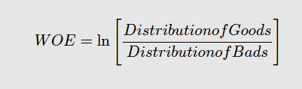
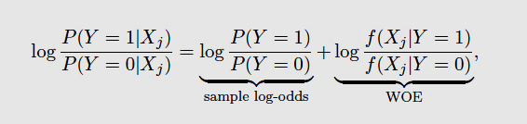
Net Information Value
What is Weight of Evidence(WOE)?
WOE concept is derived from Credit Risk Scoring, thus described in terms of Good and Bad Customers.
Weight of Evidence reveals the predictive power of the independent variable in relation to the dependent variable.
Estimating WOE:
The continues variables are split into number of bins depending on the distribution of data.
Calculate the number of Goods and Bads in all the bins
Calculate % of Goods and % of Bads in each bin.
Calculate WOE using above formula for all bins.
Notes:
There are two important terms used in NIV.
First one is Weight of Evidence and second is Information Value.
Lets discuss what is WOE?
WOE concept is derived from Credit risk scoring. Hence it is always described in terms of Good customers and Bad customers.
WOE reveals the predictive power of the independent variable to the depending variable.

Slide 12

Net Information Value
What is Information Value (IV)?
WOE describes the relationship between predictors and target, whereas IV gives the strength of that relationship.
Thus predictor variables are derived depending upon the strength.
General thumb rule for IV:
Less than 0.02 : Unpredictive.
0.02 - 0.1 : Weak
0.1 - 0.3 : Medium
>0.3 : Strong
Notes:
Second term is Information Value,
WOE describes the relationship between predictors and target where as Information value gives the strength of that relationship.
The general thumb rule for IV are as follows:

Slide 13
Net Information Value
Extension of WOE/IV Analysis for Incremental Response Modeling
In Incremental response modeling, a net lift between the behaviour of Treatment and Control group customers is analysed.
Thus only considering WOE/IV results is not enough.
One must consider log odds of Response=1 for treatment group vs control group.
Larsen introduced NWOE and NIV for IR Modeling.
Net information value can be calculated as the difference of WOEs i.e. Treatment group(WOEt) and Control group(WOEc)
Penalized Net Information Value:
The predictive ability of selected variables can drop in validation dataset.
To nullify this, a penalty term is added to the NIV.
It is the difference of WOE calculated on Training data and WOE calculated from Validation data

Slide 14
Net Information Value
Results from WebApp:

Slide 15
Thesis Goal
Background and Motivation
NIV- Variable Pre Screening
Incremental Response Modeling
Results with R Shiny Web App
Conclusion and Future Work

Slide 16
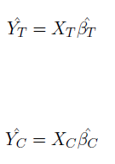

Two Model Approach
Notes:
As the name suggests, in this type of difference score calculation, two separate logistic models are built on the Treatment and Control data respectively.
Using this model, response is predicted for whole dataset.
Then in the next steps, a difference score is calculated from predicted values of both the models.
Evaluation of these difference scores is described in further slides.

Slide 17

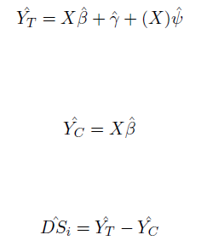
Combined Model Approach
Notes:
In this type of difference model, first a new indicator variable is introduced
Indicator=1 for treatment and =0 for control data.
Then the model is built using the formula as shown here. The model is thus built on the complete data and difference scores are calculated

Slide 18
Two Model Approach
Notes:
The Residual Deviance has reduced by
357.8 with a loss of four degrees of freedom.
540.2 with a loss of four degrees of freedom.
The null deviance shows how well the response is predicted by the model with nothing but an intercept.
The residual deviance shows how well the response is predicted by the model when the predictors are included
Accuracy of 70%

Slide 19
Single Model Approach
Notes:
The Residual Deviance has reduced by
975.6 with a loss of nine degrees of freedom.
Accuracy of 73%

Slide 20
Model Diagnosis
In both the methods, at the end, difference scores (DSi) are calculated.
These difference scores are ordered in descending order i.e. the customer (record) with highest difference score value at the top and lowest at the bottom.
These ranked observation with the decreasing order of scores are then grouped in number of bins.
For each bin, the average predicted increment values are calculated.
Basic Criteria for Good Incremental Model:
The top most bin of record should have higher (highest) incremental rate and the bottom most bin of record should have the lower (lowest) incremental rate.
The incremental rates should decrease monotonically from top bin to bottom bin.

Slide 21
Thesis Goal
Background and Motivation
NIV- Variable Pre Screening
Incremental Response Modeling
Results with R Shiny Web App
Conclusion and Future Work

Slide 22
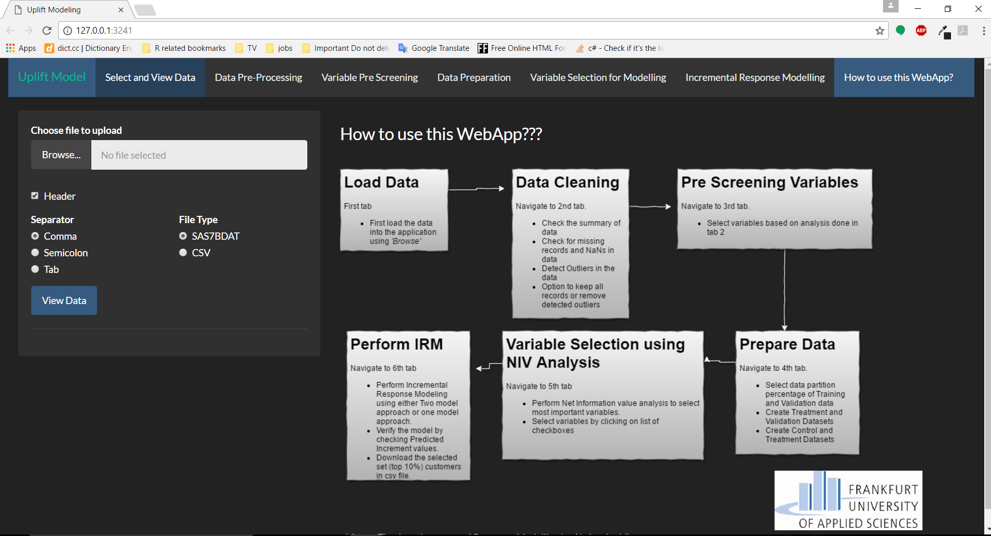
R Shiny WebApp

Slide 23
Results
Two Model Approach
Notes:
The top most bin of record should have higher (highest) incremental rate and the bottom most bin of record should have the lower (lowest) incremental rate.
The incremental rates should decrease monotonically from top bin to bottom bin.

Slide 24
Results
Combined Model Approach
Notes:
The top most bin of record should have higher (highest) incremental rate and the bottom most bin of record should have the lower (lowest) incremental rate.
The incremental rates should decrease monotonically from top bin to bottom bin.

Slide 25
Thesis Goal
Background and Motivation
NIV- Variable Pre Screening
Incremental Response Modeling
Results with R Shiny Web App
Conclusion and Future Work

Slide 26
Conclusion
Incremental Response modelling is hard — but worth it
In this thesis work, two difference score model methods are implemented for building Incremental response.
A web application is developed in Rshiny to provide a user interface to build incremental response.
Based on the thesis work done, the results obtained are quite satisfactory and can be improved with the better quality and quantity of the treatment and control group.
Notes:
To conclude, my thoughts are that Incremental response modeling is pretty hard nut to crack in the field of predictive analytics.
However, the reality though, it should not be a surprise if Incremental Response Modeling or Uplift Modeling is used as a replacement to the traditional response models

Slide 27
Future Scope and Improvements
The user interface can be improved with more functionalities to pre process the data.
Determine volume of Control Data
Variable Reduction (Different variable pre screening method can be used instead of NIV)
Multiple treatments
Incremental Sales model
Notes:
The performance of incremental response modeling is mainly dependent on the volume of control data available. In this thesis, a small dataset of 4500 records of control data is used. One can further analyse the most acceptable volume of control data set to use.
When more than one treatment (i.e. multiple offers, channels, messages, etc.) are available, the proposed methodology can be easily extended.
In this thesis implementation, treatment data contains only yes or no values. However, data could have an separate variable to define the type of treatment given to the customer. But, this could result in more interaction variables generated which will complicate the model building procedure.
This thesis covers building the incremental response models. However, this can be further extended to build the Incremental Sales model. The goal of the incremental sales model is to find customers who are likely to spend incrementally when they receive a promotion.

Slide 28
Thank you. Questions?

